Slide 1

Deployment Stacks
Tommy Sundling
Sr. Cloud Solution Architect

Slide 2

What are they
A way to group Azure resources and manage them as a cohesive unit
Similar concept to Terraform state files
Rules for what happens when resources are removed from Stack
Scope: RG, Subscription or Management Group
Managed resources can belong to different scope
Can deny deletion of resource or specific actions

Slide 3

Why are they
Re-imagining of the Azure Blueprint concept
Can be used to
Secure centrally managed resources in LZs (ex: Prevent Subscription Owner from modifying a VNET, while retaining creation/management of Subnets)
Allow flexible management of Azure Policies

Slide 4
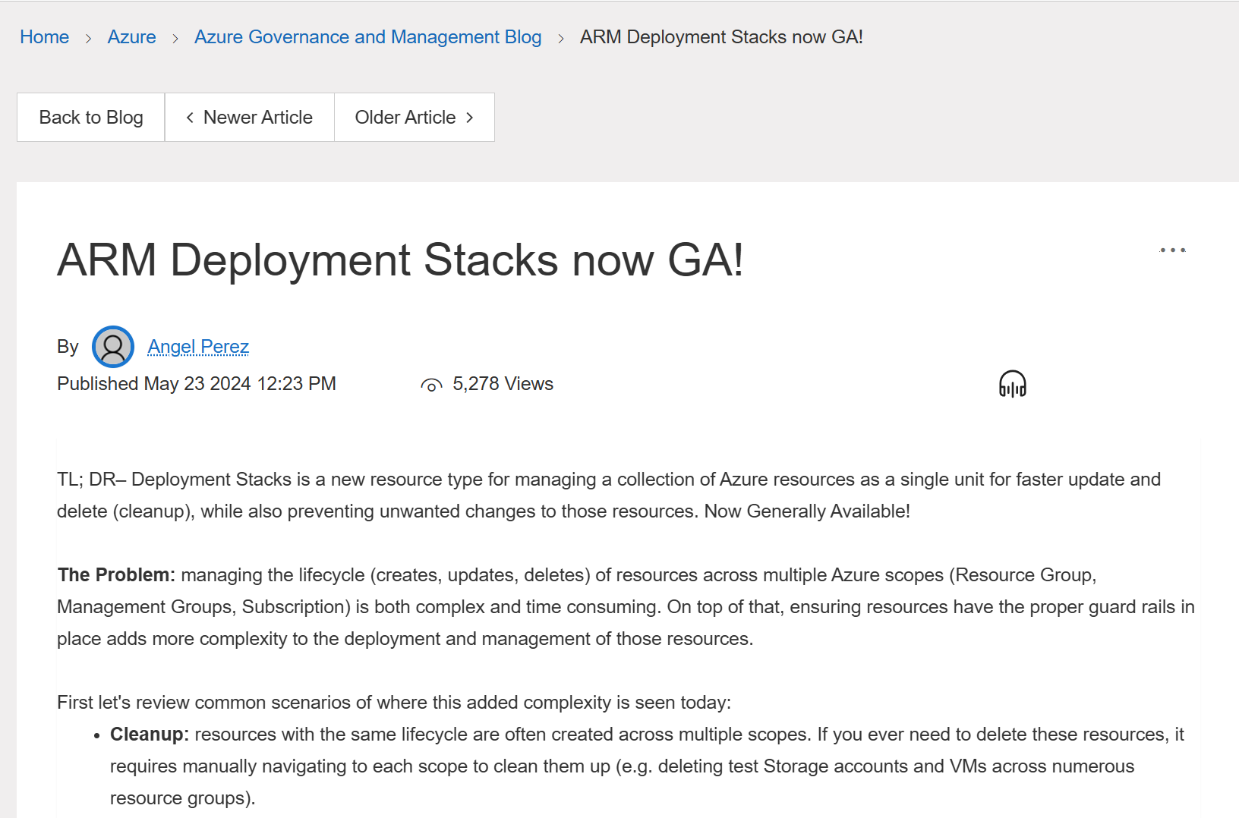
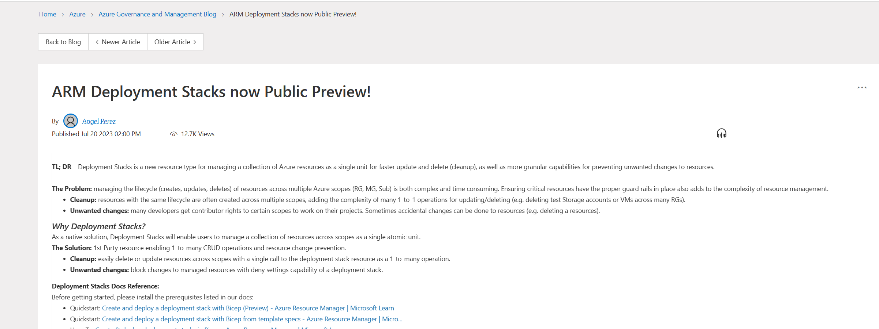
Deployment Stacks Timeline
Public Preview (2023-06-20)
GA (2024-05-23)

Slide 5
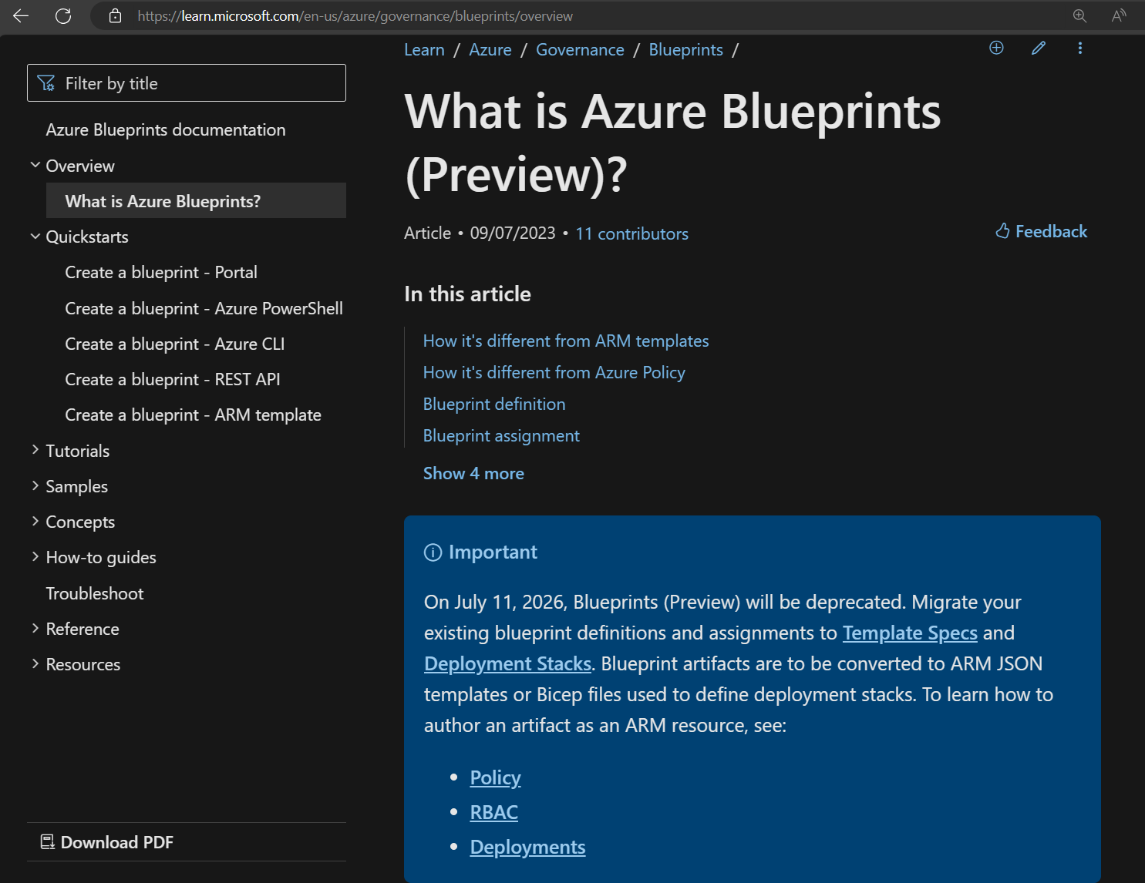
What about Azure Blueprints
Being deprecated in July 2026
Replaced by Template Specs and Deployment Stacks
Overview of Azure Blueprints - Azure Blueprints | Microsoft Learn

Slide 6
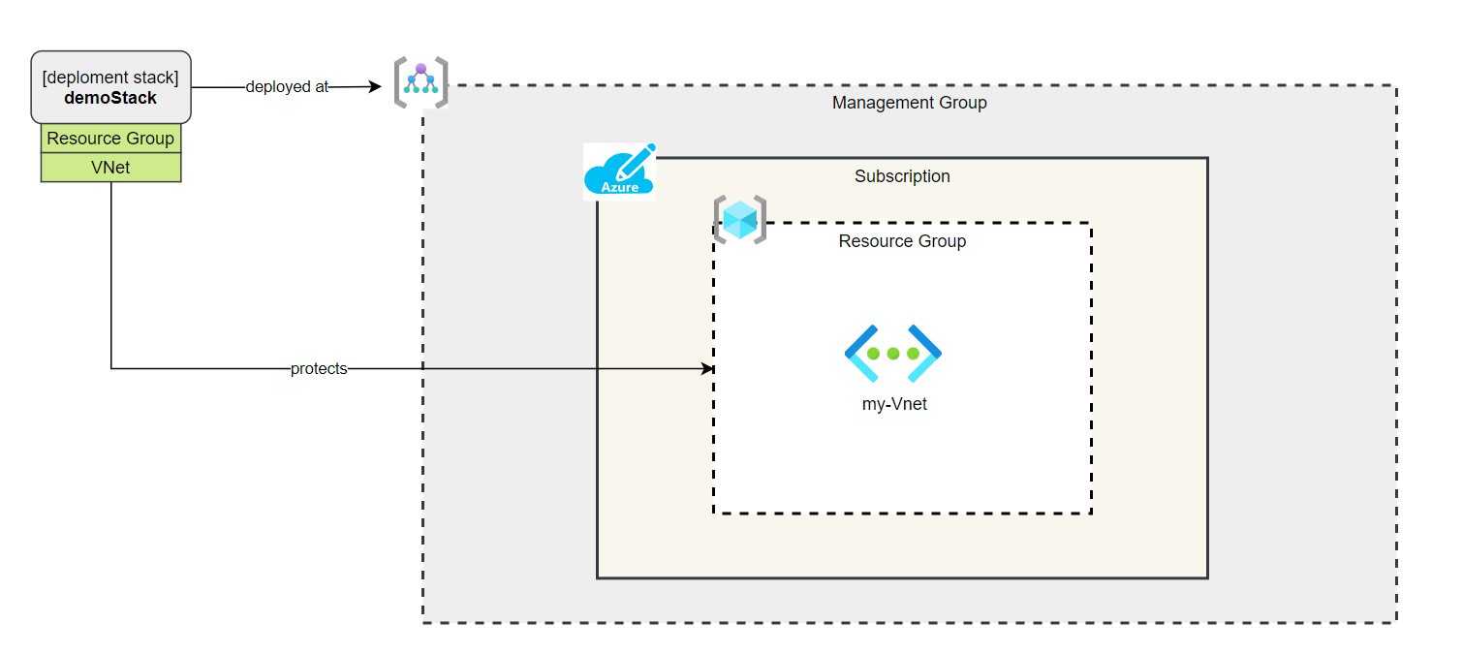
Demo – Protect a centrally managed VNet

Slide 7
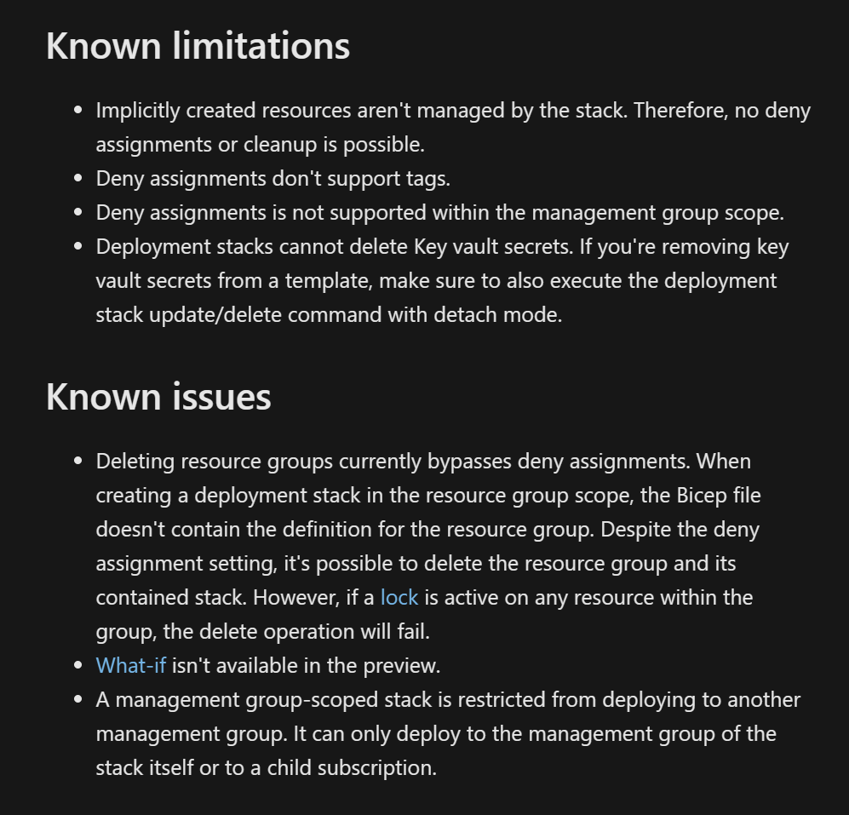
Be aware of limitations and preview issues
Create & deploy deployment stacks in Bicep - Azure Resource Manager | Microsoft Learn

Slide 8
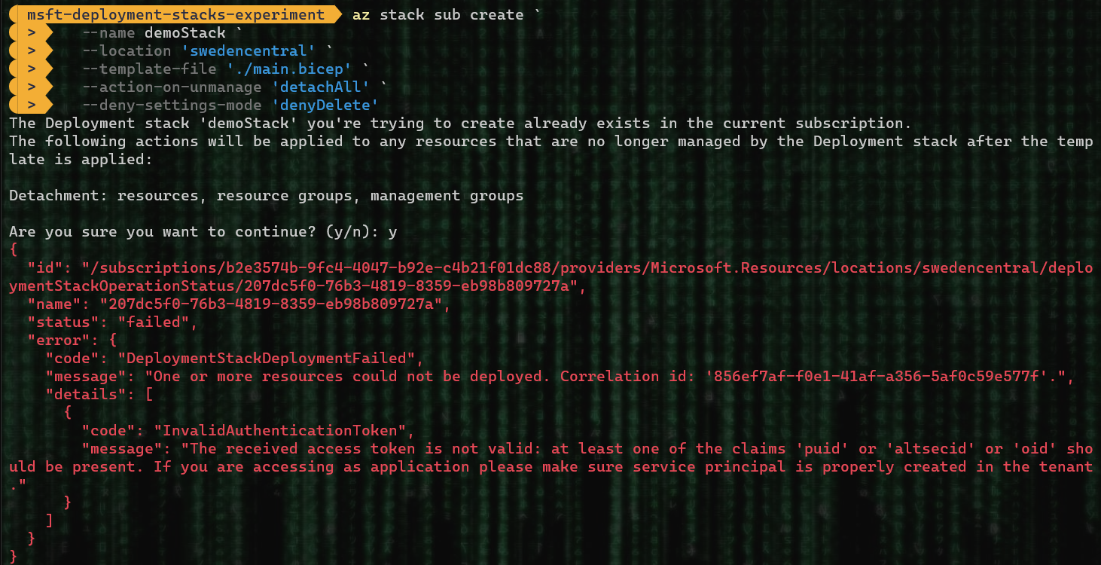
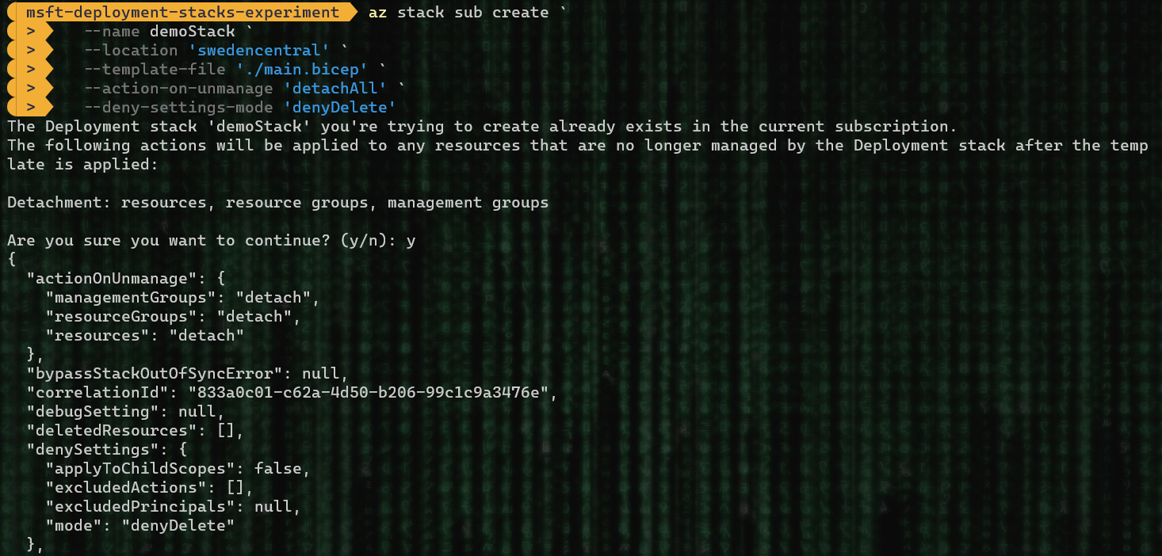
Personal Experience (past performance is no indication of future failure…)
Once deployed it works as it should ☺

Slide 9
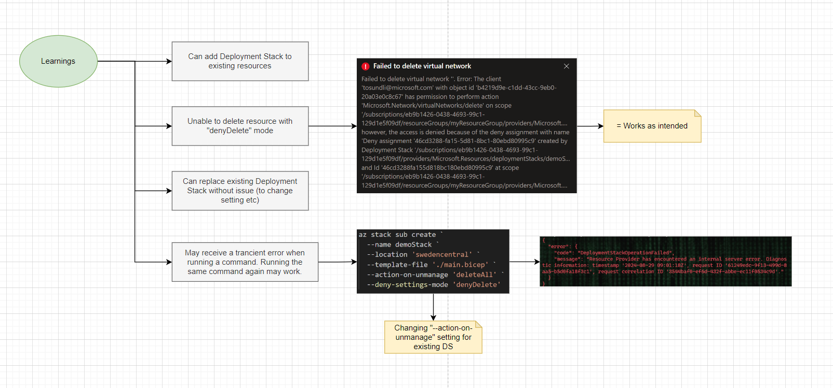
Experiences during PoC

Slide 10
Links
GA: ARM Deployment Stacks now GA! - Microsoft Community Hub
Docs: Create & deploy deployment stacks in Bicep - Azure Resource Manager | Microsoft Learn
QuickStart: Create and deploy a deployment stack with Bicep - Azure Resource Manager | Microsoft Learn

Slide 11
Microsoft Logo

